Slide 1




WINNING
STRATEGIES
for serving francophone clients
INFORMATION SESSION
for health service providers

Slide 2

We wish to acknowledge that we are virtually meeting on unceded Algonquin territory. We would like to thank the Algonquin Nation for allowing us to be guests on this land. Some of you may be joining from other regions, so feel free to share your recognition of the land in the chat. As we enter the month of June, please take the time to learn about ongoing summer solstice events and opportunities to learn and share the rich cultures of indigenous peoples.

Slide 3





AGENDA
Winning strategy objectives
Winning strategies and your agreements on French-language services
The next steps in the project
Your support team
Questions period

Slide 4


Opening poll

Slide 5
Winning strategy objectives
  Promote a more effective active offer of health services in French that are accessible to Francophones;
  Offer pragmatic tools that make it easier to implement each of the winning strategies.

Slide 6
Winning strategies and your agreements on French-language services
Here's how winning strategies align with the French-language service delivery requirements of your accountability agreements:

Slide 7

WINNING STRATEGIES
ONTARIO HEALTH
MINISTRY OF HEALTH & MCCSS
Quality Improvement Plan (QIP)
Health - Equity, Inclusion, diversity and Anti-Racism Plan (HEIDA - R)
Annual report on French-language services (FLHSD)
Designation of organizations under the French Language Services Act
French language services (FLS) Quality Improvement Plan
1. | Identify one or more champions
2. | Empower staff members in the active offer of health services in french
3. | Identify staff members able to provide services in French
4. | Identify Francophone clients
5a. | Match Francophone clients with staff members able to provide services in french
5b. | Refer Francophone clients to another provider offering same services of equal quality in french
6. | Measure results
from Referral Clause
from Referral Clause
from Clause 1
from Referral Clause
from Clause 1
from Referral Clause
from Clause 1
Click here to view the original document

Slide 8





The next steps in the project
  Implement your plan's objectives
Here are the steps we suggest you follow to facilitate the implementation of winning strategies within your organization.
  Develop your work plan
  Choose and register your champion for training
  Complete the self-assessment questionnaire
Watch the webinar

Slide 9

New tool: the
self-assessment questionnaire
Objectives :
  Evaluate organizational practices related to winning strategies already implemented within your organization;
  Identify the most relevant winning strategies to implement within your organization;
  Gather evidence on the organizational practices of Ontario Health Team partners towards the Francophone population;
  Evaluate the scope and impact of the project.

Slide 10
New tool: the
self-assessment questionnaire (cont’d)
How long will I need to complete the self-assessment? 15 minutes.
Who should complete the self-assessment? Someone who is familiar with your organization's practices (e.g. your winning strategies champion).
Who will have access to the information provided in your self-assessment questionnaire?
  Your organisation;
  Your OHT;
  The Winning Strategies Committee.
My organisation is designated under the French Language Services Act. Do I have to complete the self-assessment? Yes, it would be preferable for all Ontario Health Team’s partners to complete the questionnaire.

Slide 11

New tool: the
self-assessment questionnaire (cont’d)
Click here to complete the self-assessment questionnaire.

Slide 12

Choose and register your champion for training for champions
Training objectives:
  To provide organizational champion(s) with an opportunity to enhance their existing knowledge of winning strategies;
  Develop the necessary skills to enable successful implementation of winning strategies within the organization.

Slide 13
Choose and register your champion for training for champions (cont’d)
Training in French (12pm-1pm):
17 July 2024
30th July 2024
7th August 2024
13th August 2024
21st August 2024
Training in English (12pm-1pm):
18 July 2024
1 August 2024
8th August 2024
15th August 2024
22 August 2024

Slide 14

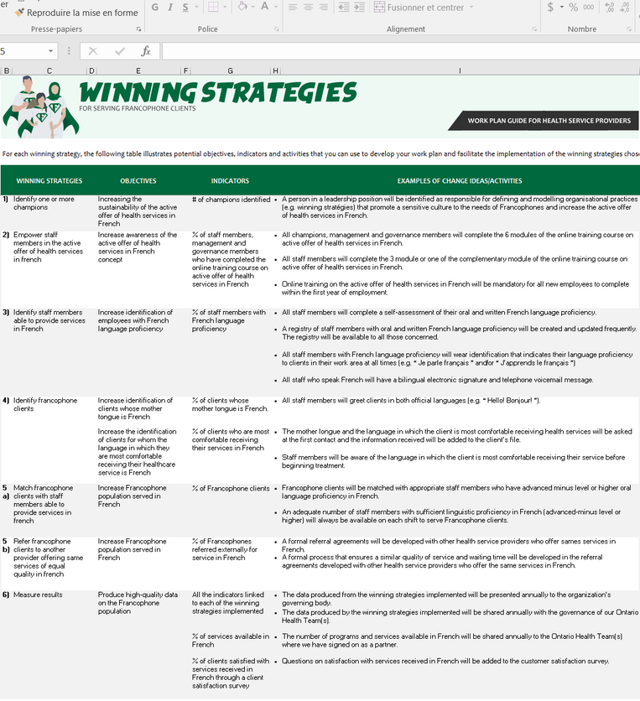
Implement your plan's objectives
Click here to view the original document

Slide 15

Implement your plan's objectives
  Pragmatic tools for every winning strategy;
  A community of practice (under development);
  Personalised support from a member of the Réseau des services de santé en français de l'Est de l'Ontario (RSSFE).
Visit www.rssfe.on.ca

Slide 16

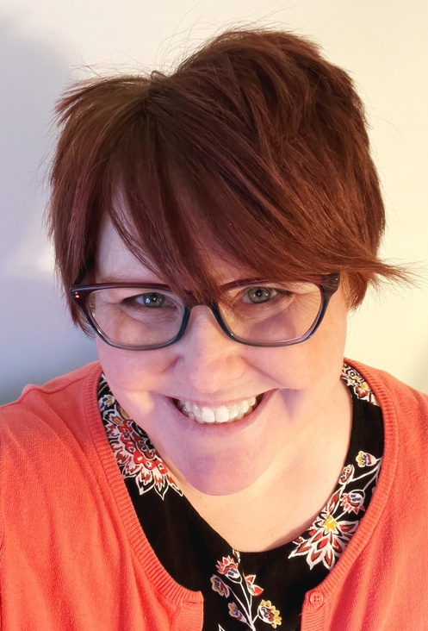

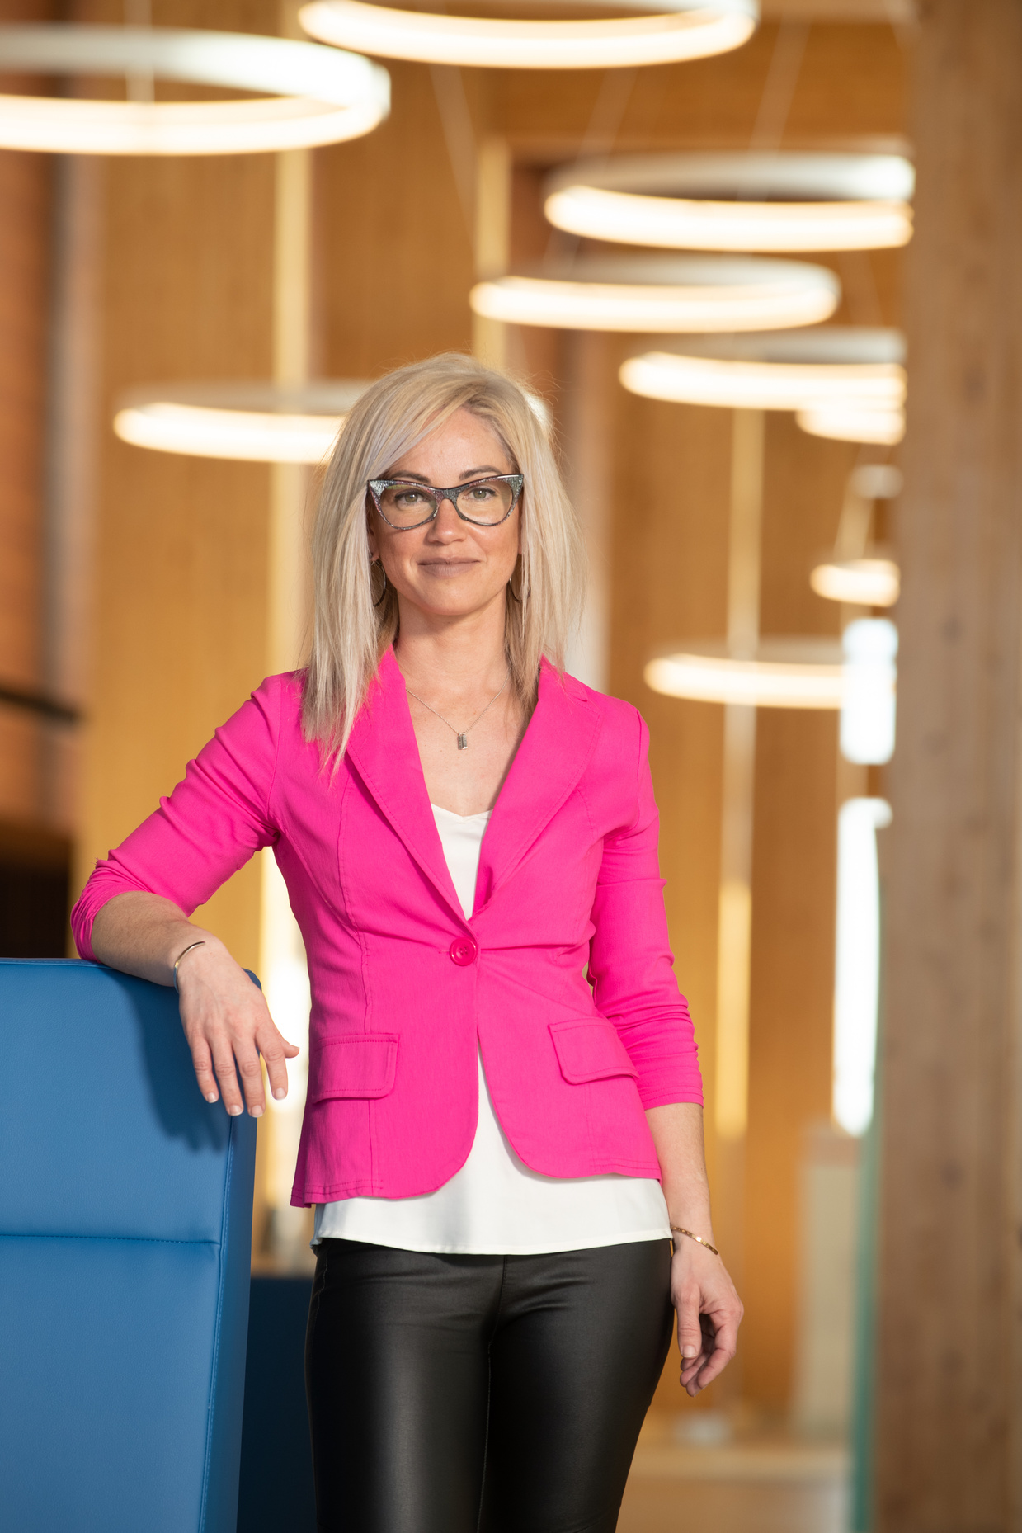
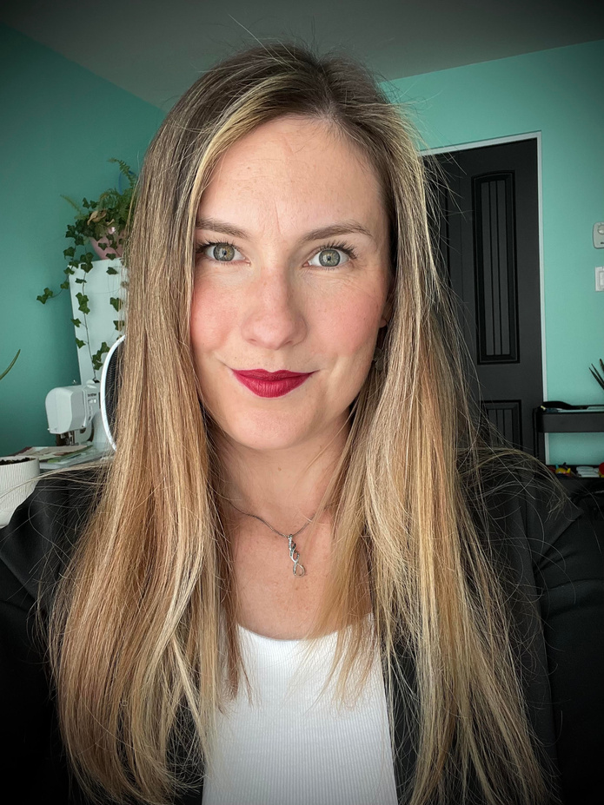

Your support team
Carly Haydt
(à venir)
Marie-Lou
Meawasige
Michelle Goulet
Project Manager
&
Project coordinator for the Kids Come First Health team
Project coordinator for all Ontario Health teams involved
Coordinator of support for service providers in implementing winning strategies
Project coordinator for the Archipel Ontario Health team

Slide 17
Your support team (cont’d)
Carly is the Project Manager for Kids Come First and supports The Winning Strategies working group by assisting with the coordination of various tasks, including scheduling, communication, reporting and collaboration.
You can reach her via email at chaydt@cheo.on.ca.
Carly Haydt
Project Manager
&
Project coordinator for the Kids Come First Health team

Slide 18
Your support team (cont’d)
  As the Population Health Manager at Archipel Ontario Health Team (OHT), Marie-Lou Meawasige (she/her/elle) works cohesively with the team to plan the implementation of the Winning Strategies Protocol.
  Serving as the primary point of contact for her OHT, Marie-Lou brings her expertise by offering guidance to the support and planning team, ensuring a cohesive and efficient approach by and for OHTs.
  Moreover, she will collaborate closely with the coordinator (once hired), ensuring robust communication channels are established both within and across all OHTs, facilitating the seamless exchange of information vital to the successful implementation of their plans and strategies.
Email: marieloumeawasige@eso-archipel.ca
Marie-Lou
Meawasige
Project coordinator for the Archipel Ontario Health team

Slide 19
Your support team (cont’d)
Michelle is a planning officer for the Réseau des services de santé en français de l'Est de l'Ontario (RSSFE) and the project's service provider support coordinator. She is one of the investigators of the Winning Strategies project and specialises in supporting health service provider partners. You can contact her if you have any questions about:
  winning strategies and their implementation ;
  training on active offer
  French-language health services
  training for champions
  work plan development
  French-language health services;
  the French Language Services Act.
E-mail: mgoulet@rssfe.on.ca
Michelle Goulet
Coordinator of support for service providers in implementing winning strategies

Slide 20
Questions period
Do you have any questions?
If you have any questions about the project, please do not hesitate to contact winningstrategies@kidscomefist.ca

Slide 21
Closing poll

Slide 22


